Slide 1


Marathwada Mitra Mandal’s
College of Engineering
Karvenagar, Pune
Accredited with “A’ Grade by NAAC
Recipient of Best College Award in AY 2018-19 from SPPU
Department of Information Technology
Internship
on
“CUSTOMER SEGMENTATION (using K-Means)”
Domain - Data Science
Name of Mentor :
Mr.Aravind R&D Engineer
Company Name & address: Exposys Data Labs,Bengaluru
Presented By:
Nayan H Kacha
Faculty Mentor:
Rupali Chopade Mam

Slide 2
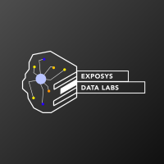
EXPOSYS DATA LABS
Bengaluru - India
Created by:
Name = Nayan H Kacha
Domain = DATA SCIENCE
Topic = CUSTOMER SEGMENTATION (using K-Means)

Slide 3
INDEX
Introduction
Background
Problem statement
Methodology
Technonogy
Implementation
Conclusion

Slide 4
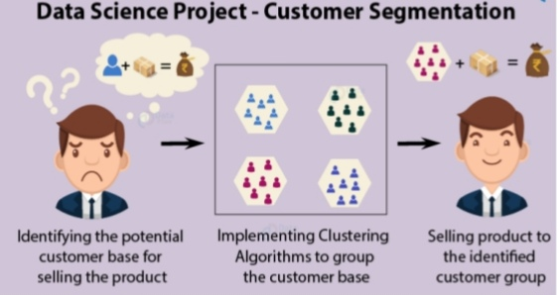
Customer Segmentation (using K-Means)

Slide 5
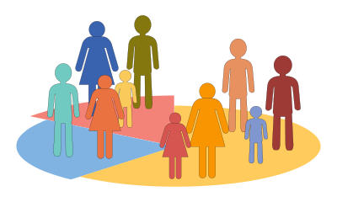
INTRODUCTION What is Customer segmentation?
Customer Segmentation is the process of division of customer base into several groups of individuals that share a similarity in different ways that are relevant to marketing such as gender, age, interests, and miscellaneous spending habits.
In our project we used following packages:
• Pandas (version: 1.1.5)
• Numpy (version: 1.19.2)
• Matplotlib (version: 3.3.2)
• Scikit Learn (version: 0.23.2)
• Seaborn (version: 0.11.1)

Slide 6
BACKGROUND: Dataset Description:
The data is given by Exposys Data Labs.
It has individual unique customer IDs, A categorical variable in the form of Gender and three columns of Age, Annual Income and Spending Score .

Slide 7
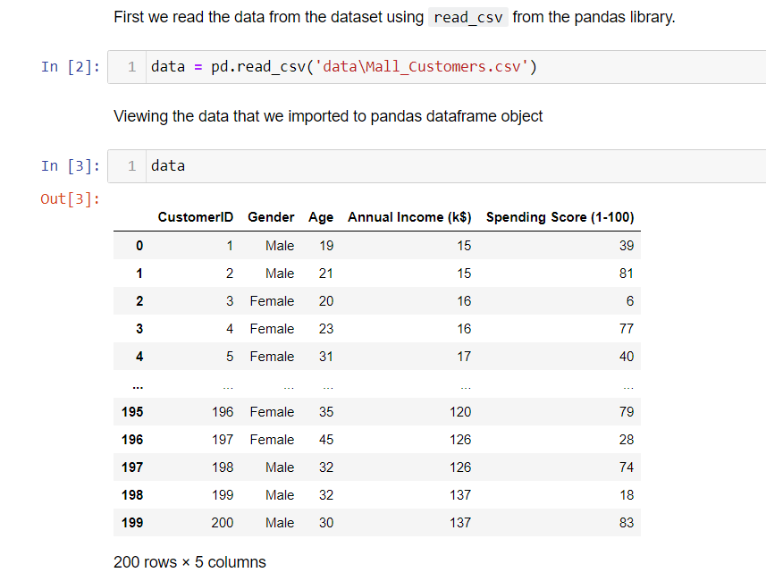


Slide 9
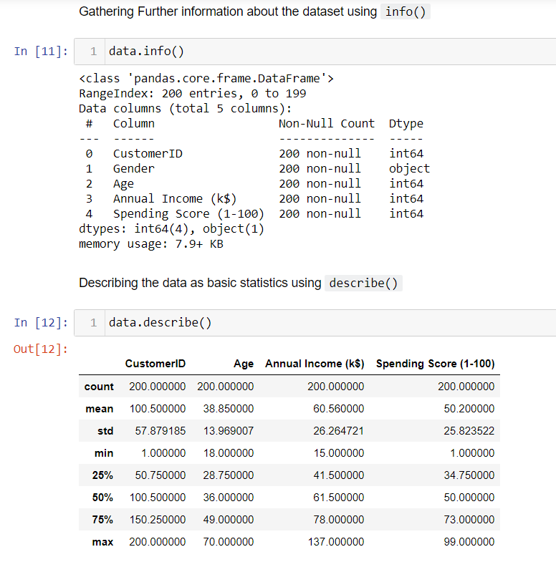

Slide 11
PROBLEM STATEMENT:
To find the best customer, using customer segmentation methodology.
To explore the data upon which building a segmentation model.
Also, in this project, we will see the descriptive analysis of our data and then implement the K-means algorithm.

Slide 12
OBJECTIVE
The objective of the project are as follows:
Identify the potential customer base for selling the product.
Implement Clustering Algorithms to group the customer base.

Slide 13
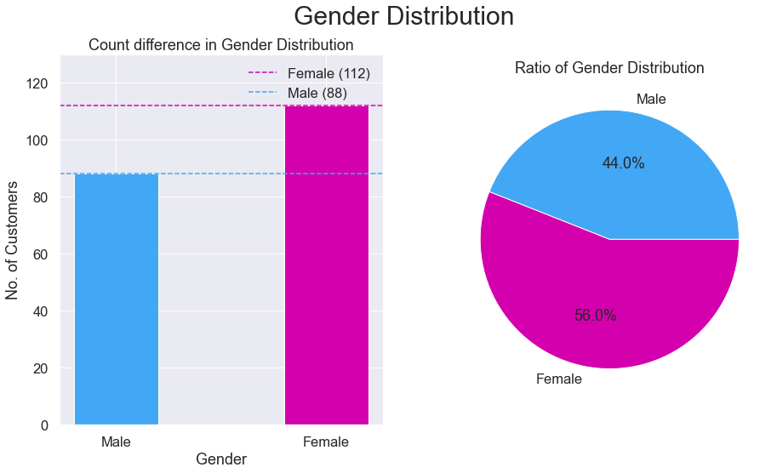
METHODOLOGY: EXPLORATORY DATA ANALYSIS
Visualization of Distribution of Males and Females:

Slide 14
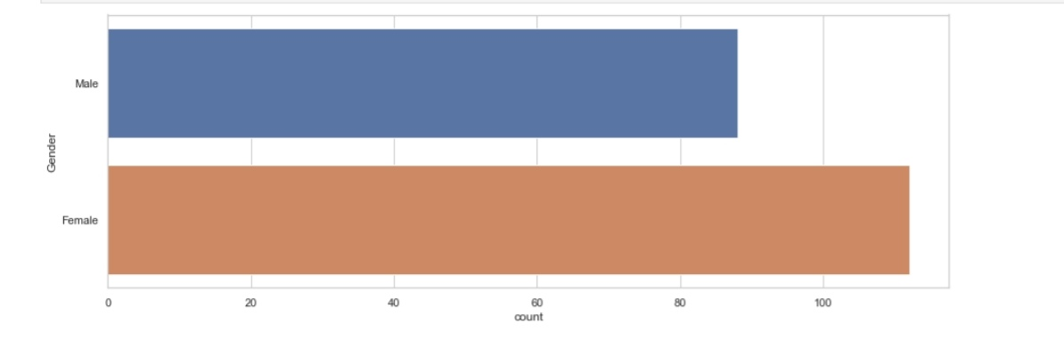
From the above graphs, we observe that the number of females(112) is higher than the males(88). The Ratio of Gender population is 56% Females and 44% Males. By this we can say that majority of the customers that visit the mall are Females.

Slide 15
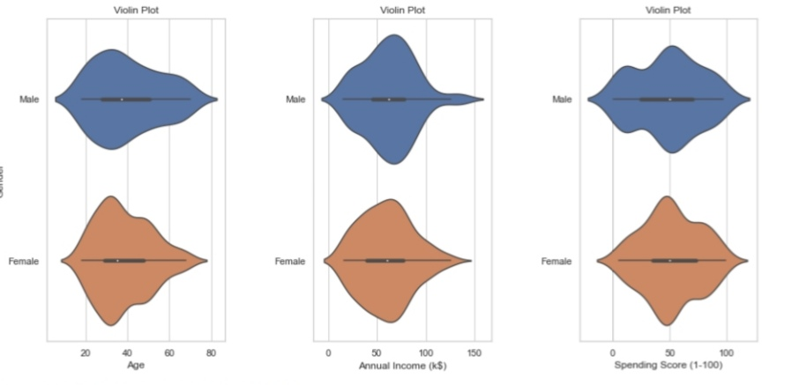

Slide 16
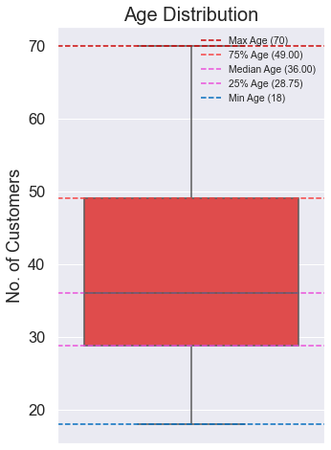
AGE ANALYSIS OF CUSTOMERS
From the above boxplot, we can conclude that a large amount of ages are between 30 and 35. Min Age is 18, Max Age is 70. By comparing the age distribution of the customers, we can conclude that most of the customers were within the band between 30 to 50, where the mean is around 35 years old.

Slide 17
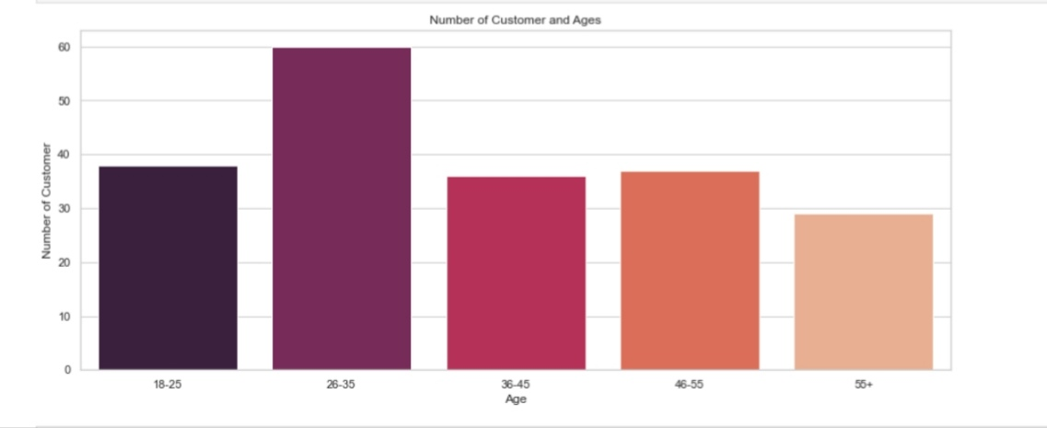

Slide 18
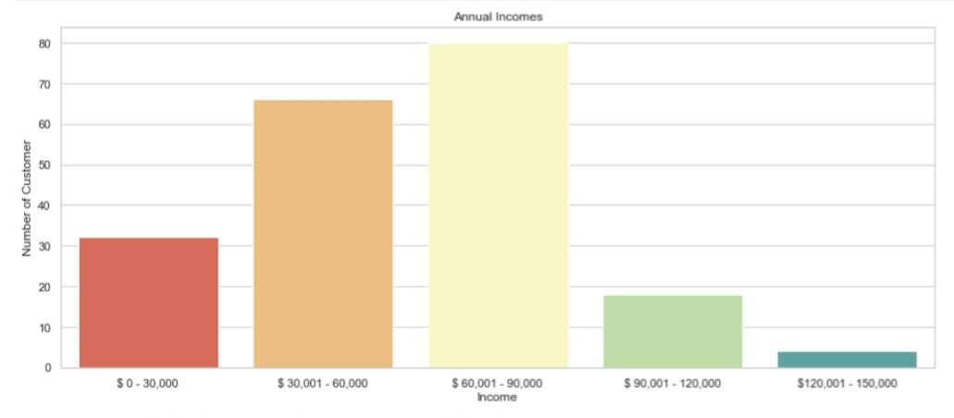
Annual Income and Spending Score Analysis:
The distribution of Annual Income and Spending Score exhibited an approximation of normal distribution, with highest density around the mean of the variables. The maximum and minimum of Annual Income are 137 and 15 respectively, with the mean at 60.56. From the plot, we can see that the peak of the distribution fell in the region of 60 to 75.

Slide 19
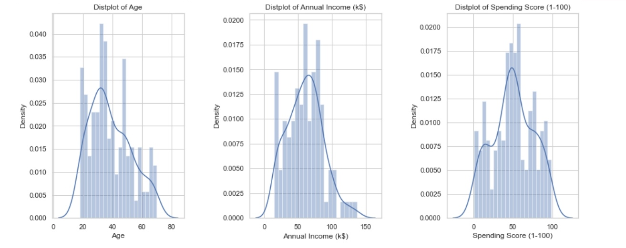
For the Spending score, the maximum and minimum are 99 and 1, while the distplot indicated that the highest number of customers have the spending score ranging from 40 to 60.

Slide 20
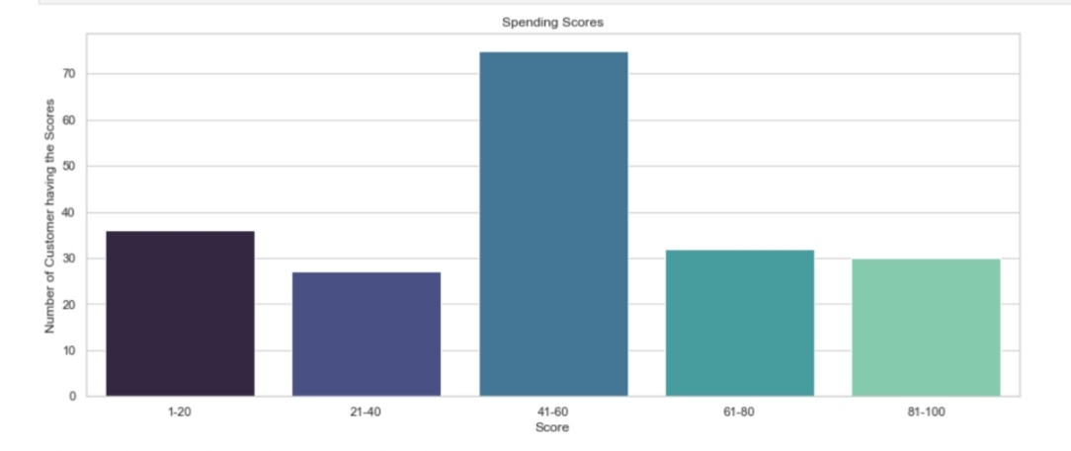

Slide 21
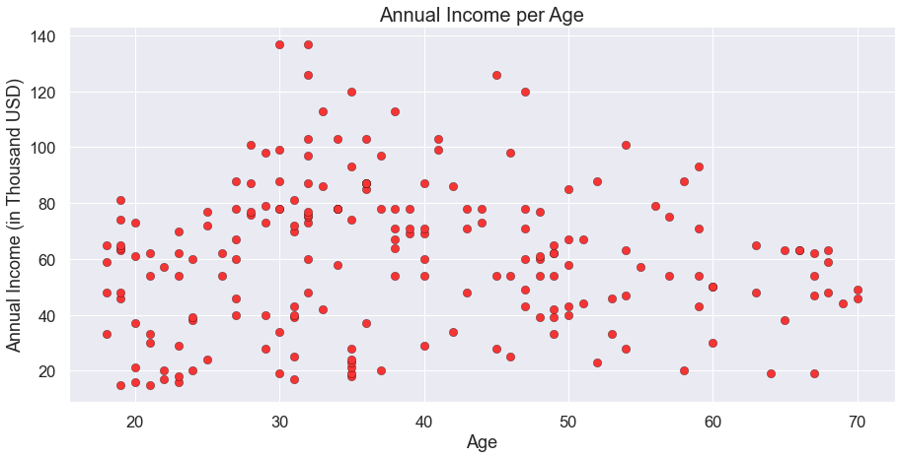
CHARACTERISTIC RELATIONS
Annual Income vs Age analysis:

Slide 22
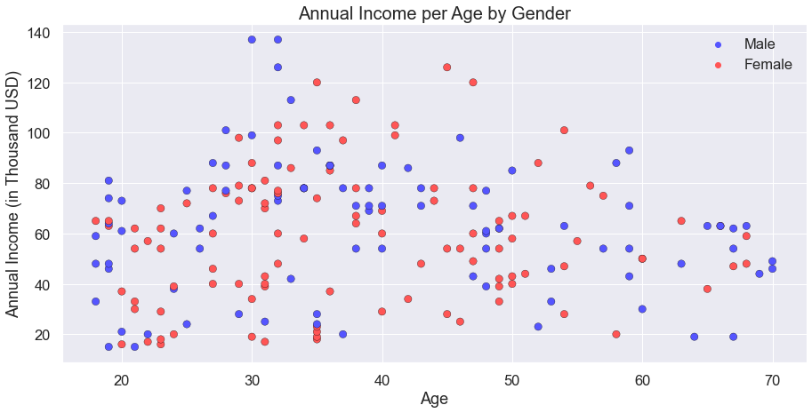

Slide 23
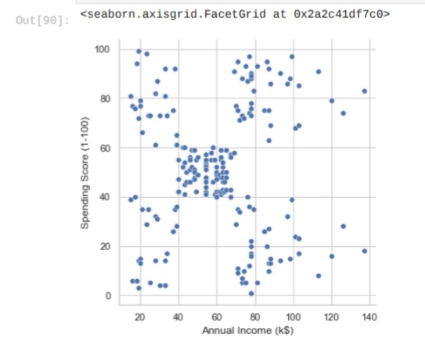
SPENDING SCORE VR AGE ANALYSIS

Slide 24
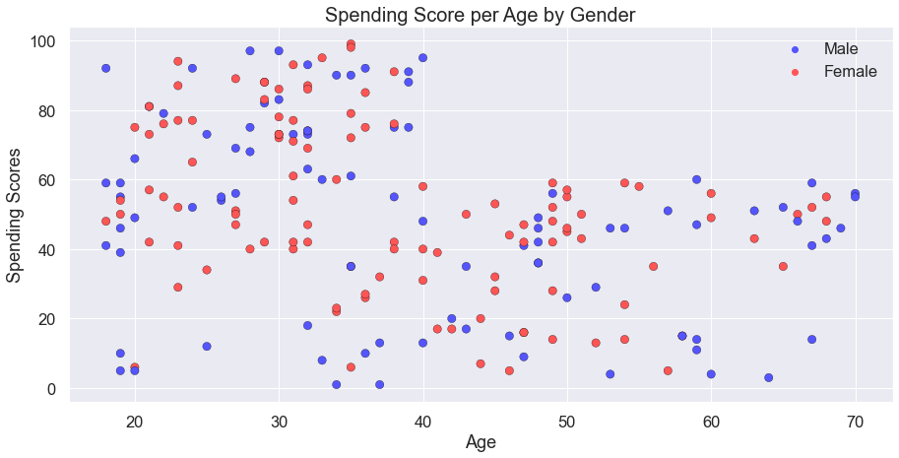

Slide 25
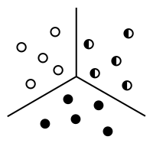
WHAT IS CLUSTERING ?
The process of segregating objects into groups based on their respective characteristics is called clustering. In clusters, the features of objects in a group are similar to other objects present in the same group.
K-Means Clustering
The process of segregating objects into groups based on their respective characteristics is called clustering. In clusters, the features of objects in a group are similar to other objects present in the same group.

Slide 26
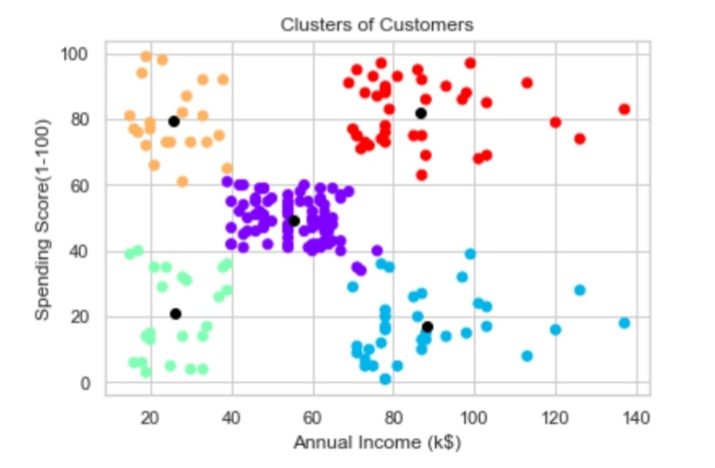
Building the k-means model
We need to visualize the data which we are going to use for the clustering. This will give us a fair idea about the data we're working on. This will give us a fair Idea and patterns about some of the data.

Slide 27

The elbow method
The Elbow method runs k-means clustering on the dataset for a range of values for k (say from 1-10) and then for each value of k computes an average score for all clusters. By default, the distortion score is computed, the sum of square distances from each point to its assigned center.
We use the Elbow Method which uses Within Cluster Sum Of Squares (WCSS) against the the number of clusters (K Value) to figure out the optimal number of clusters value. WCSS measures sum of distances of observations from their cluster centroids which is given by the below formula.
where Yi is centroid for observation Xi. The main goal is to maximize number of clusters and in limiting case each data point becomes its own cluster centroid.

Slide 28
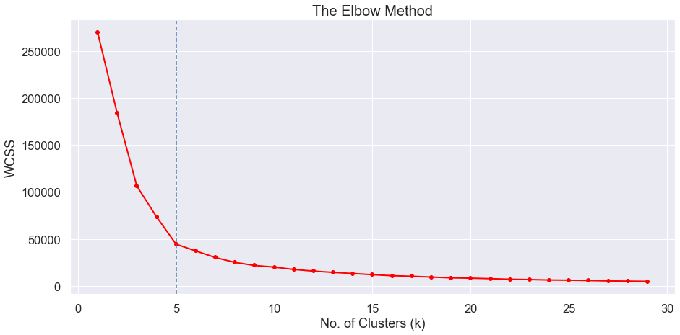
It is clear, that the optimal number of clusters for our data are 5, as the slope of the curve is not steep enough after it. When we observe this curve, we see that last elbow comes at k = 5, it would be difficult to visualize the elbow if we choose the higher range.

Slide 29
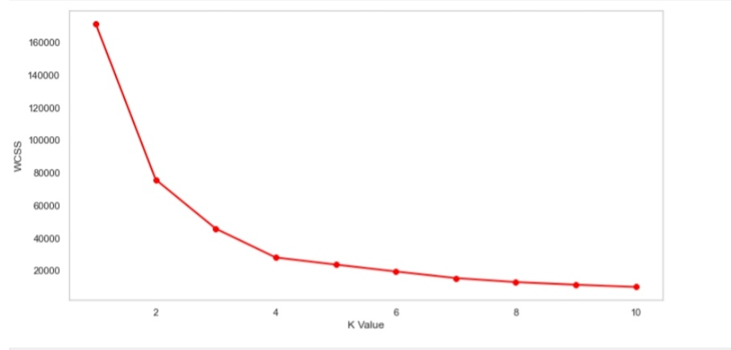
Elbow method – age , spending score

Slide 30
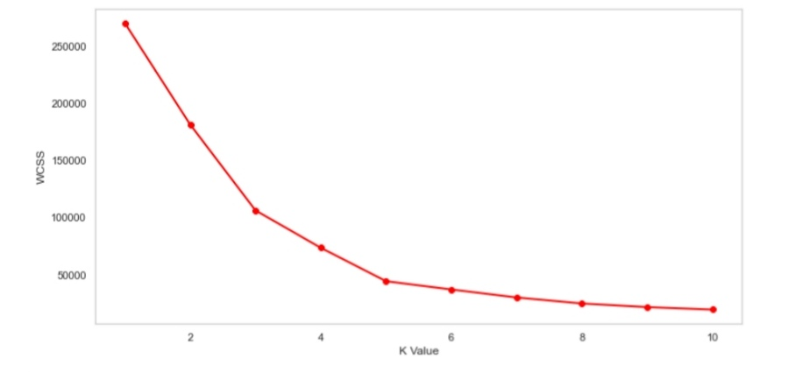
Elbow method – annual income , spending score

Slide 31
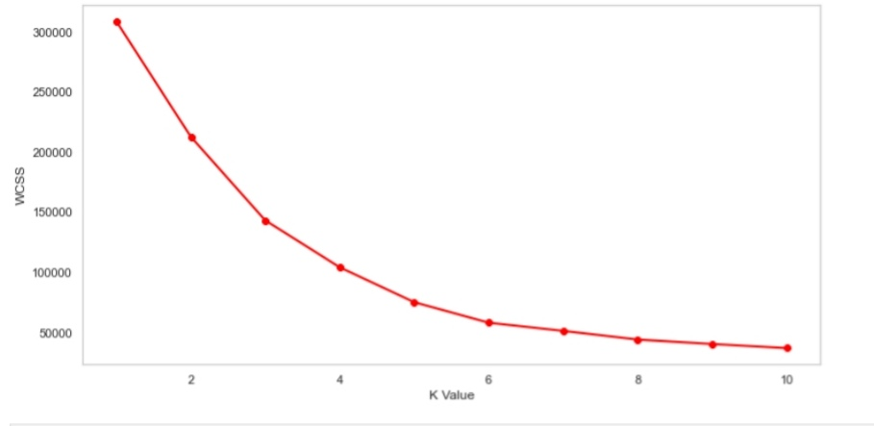
Elbow method – AGE , Annual income , spending score

Slide 32
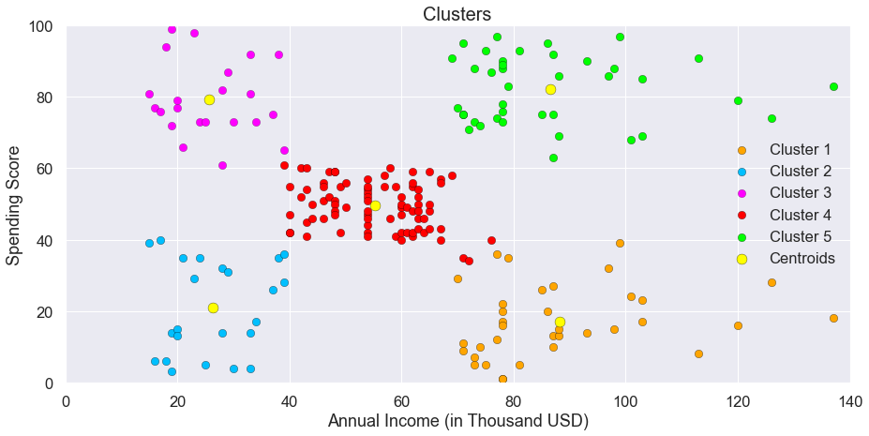
Cluster analysis :
The following clusters are created by the model,
Cluster Orange
Cluster Blue
Cluster Purple
Cluster Red
Cluster Green

Slide 33
CLUSTER ORANGE – BALANCED CUSTOMERS:
They earn less and spend less. We can see people have low annual income and low spending scores, these are the wise people who know how to spend and save money. The shops/mall will be least interested in people belonging to this cluster.
CLUSTER BLUE – PITCH PENNY CUSTOMERS:
Earning high and spending less.. These can be the prime targets of the mall, as they have the potential to spend money. So, the mall authorities will try to add new facilities so that they can attract these people and can meet their need
CLUSTER PURPLE – NORMAL CUSTOMERS:
Customers are average in terms of earning and spending, these people again will not be the prime targets of the shops or mall, but again they will be considered and other data analysis techniques may be used to increase their spending score.

Slide 34
CLUSTER RED – SPENDERS :
This type of customers earns less but spends more Annual Income is less but spending high, so can also be treated as potential target customer. The shops/malls might not target these people that effectively but still will not lose them.
CLUSTER GREEN – TARGET CUSTOMERS:
Earning high and also spending high Target Customers. Annual Income High as well as Spending Score is high, so a target consumer. These people might be the regular customers of the mall and are convinced by the mall’s facilities.

Slide 35
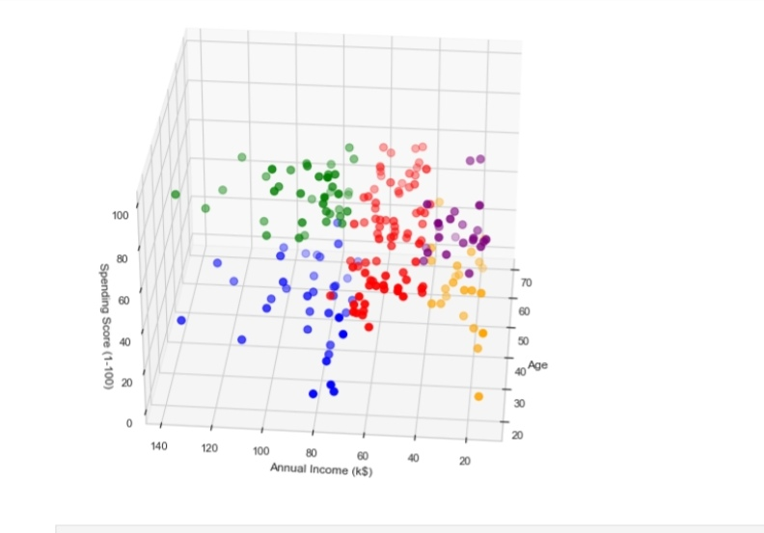
3-d plotting of annual income , age , spending score

Slide 36
CONCLUSION:
If you properly manage the best current customer segmentation process, however, the impact it can have on every part of your organization — sales, marketing, product development, customer service, etc. — is immense.
We have explored the five segments based on customers Annual Income and Spending Score which are reportedly the best factors/attributes to determine the segments of a customer in a Mall.
There can be many marketing strategies applied for Customers on this Cluster Analysis. High income and High spending score customers are our target customers and we would always want to retain them as they give the most profit margins to our organization.
High Income and Less spending score customers can be attracted with wide range of products in their life style demands and it might attract them towards the Mall Supermarket.

Slide 37
thank you……

